Slide 1
Adaptive Merging for Rigid Body Simulation
EULALIE COEVOET, OTMAN BENCHEKROUN, and PAUL G. KRY McGill University
2020 SIGGRAPH
Vedio: https://youtu.be/mmVVRVt8EF4
Reporter: 徐泽铭 22055156

Slide 2
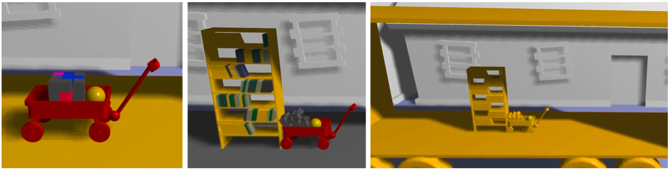
Contribution
Reduce computation time in rigid body simulations by merging collections of bodies when they share a common spatial velocity.
The merging of bodies with a common relative velocity
A single iteration PGS to refine forces internal to collections
Contact ordering for responsive unmerging
Easily tuned parameters for merging and unmerging

Slide 3
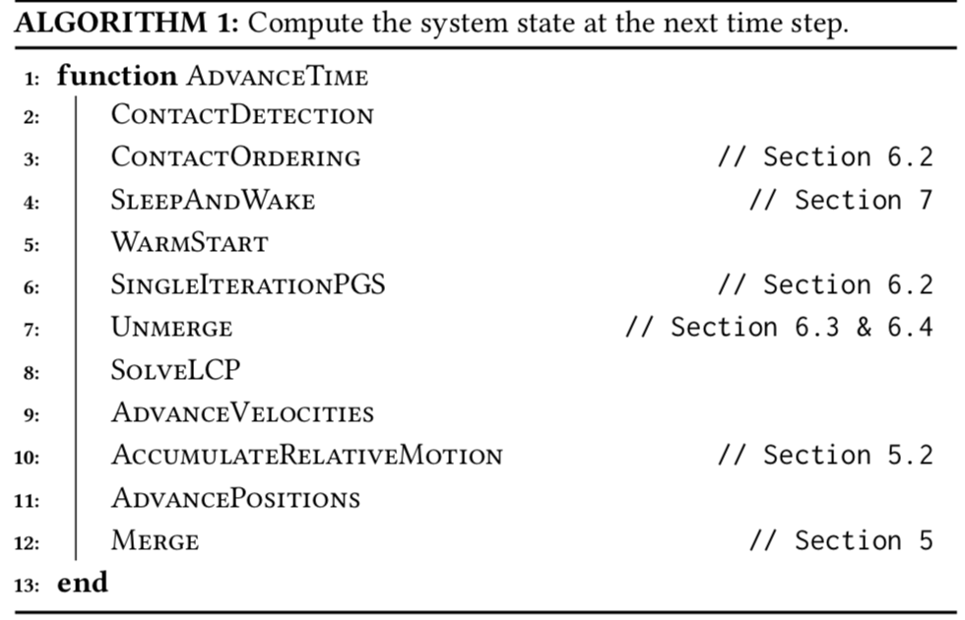
Algorithm
Contact ordering: 对接触碰撞进行排序，优先从新检测到的碰撞开始（如冲击）
Single Iteration PGS： 使用PGS方法求解collection内部的力
Solve LCP：求解线性互补问题计算相关参数，如速度等。
LCP与PGS：http://image.diku.dk/kenny/download/erleben.13.siggraph.course.notes.pdf

Slide 4
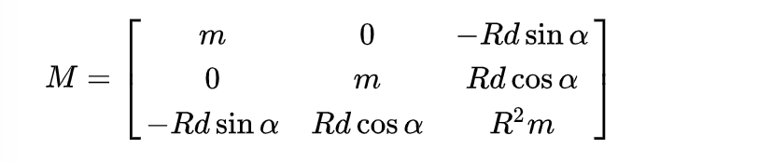


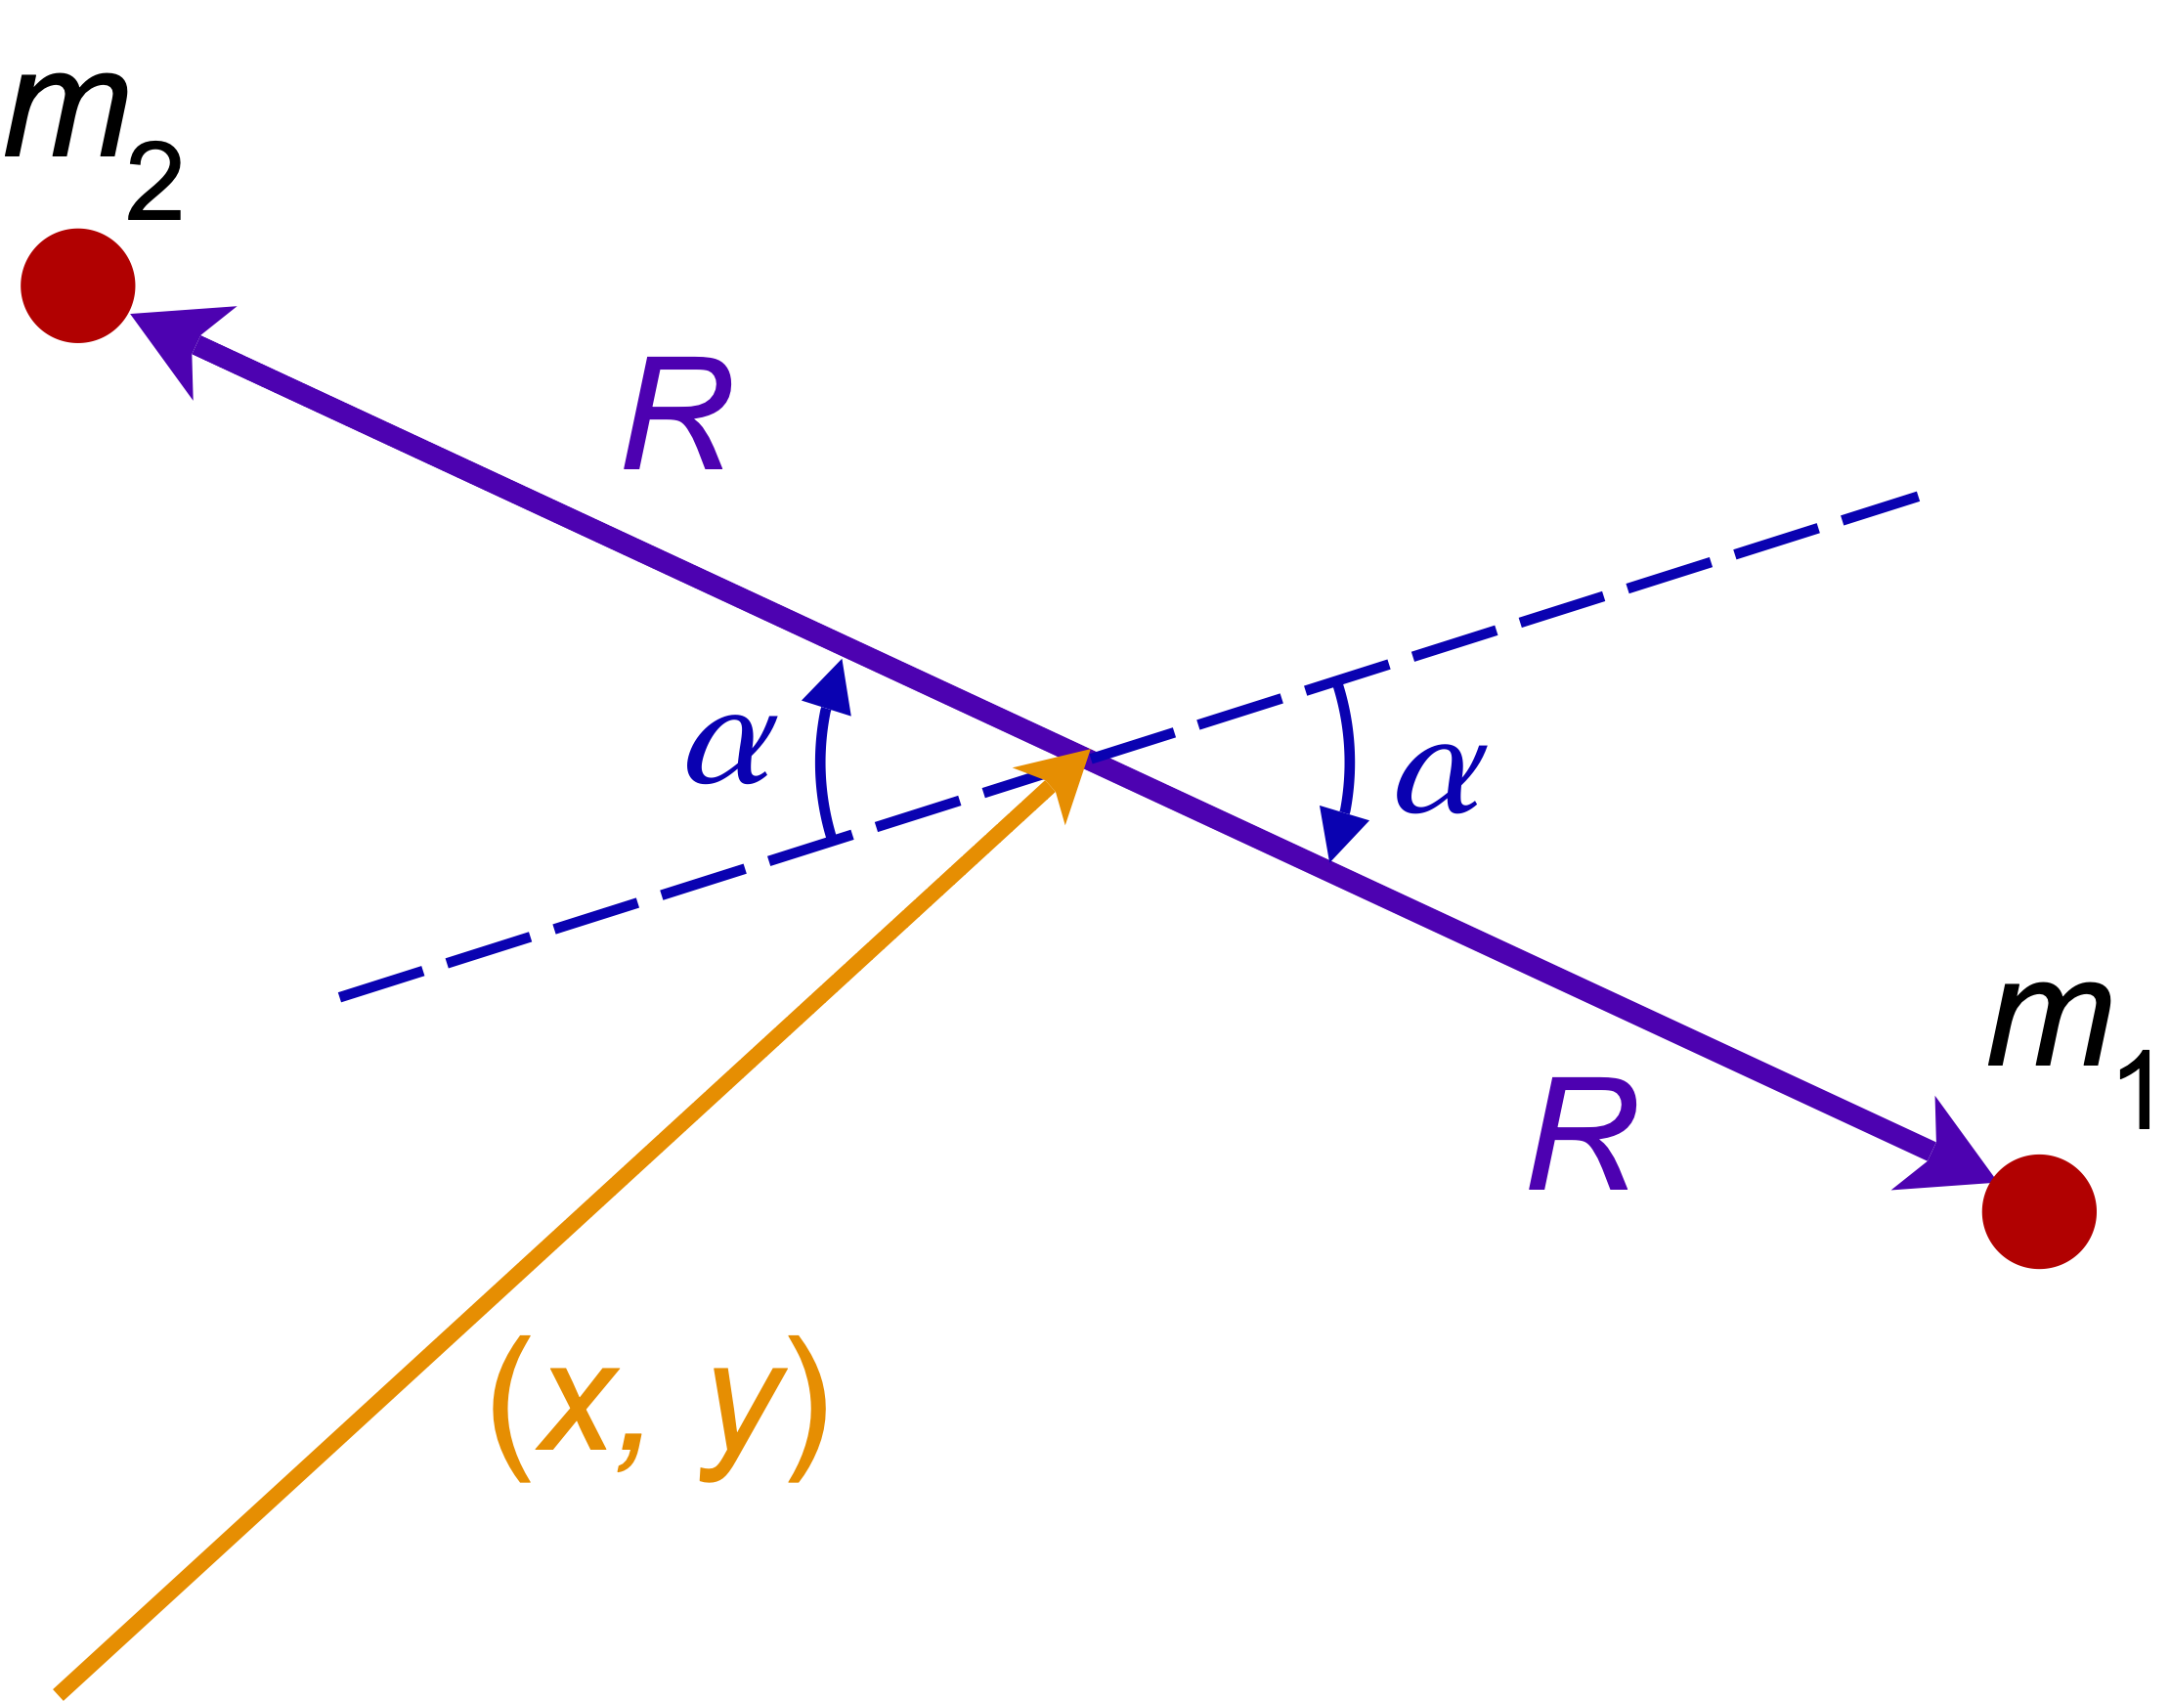
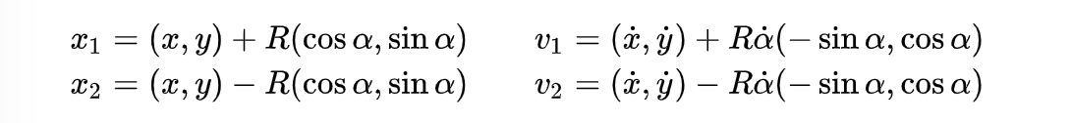

Multi-Body Dynamics
The dynamic equations of motion
M：mass matrix
如图系统的状态我们可以使用向量q来表示：
其中（x, y）是图中刚体杆的中心
则两个点状刚体m1,m2的位置x1,x2为
- 它们的总动能为：
- 即：

Slide 5

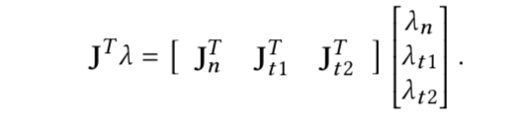

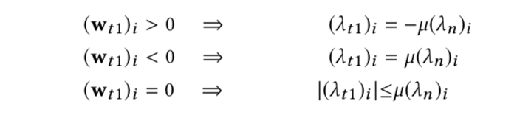
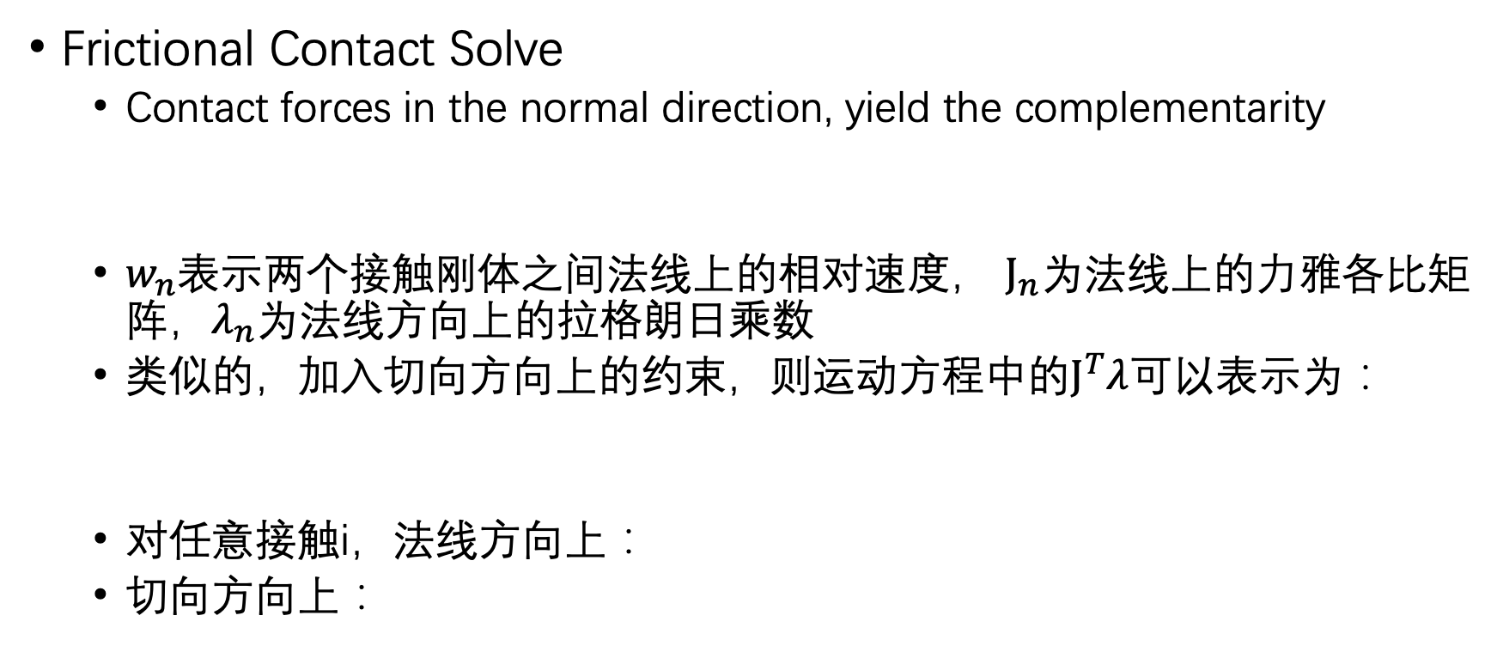
Multi-Body Dynamics
Frictional Contact Solve
Contact forces in the normal direction, yield the complementarity
$w_{n}$表示两个接触刚体之间法线上的相对速度， $J_{n}$为法线上的力雅各比矩阵，$λ_{n}$为法线方向上的拉格朗日乘数
类似的，加入切向方向上的约束，则运动方程中的$J^{T}λ$可以表示为：
对任意接触i，法线方向上：
切向方向上：
Notes:
当发现方向上有相对速度时，很显然两个物体之间的接触力消失，所有法线上的拉格朗日乘数为0；
互补的，当发现上的拉格朗日乘数大于0时，说明物体之间存在接触力（挤压），即两个物体没有相对速度，即wn = 0；

Slide 6



Multi-Body Dynamics
solve $w$
- 对运动方程在一定时间h上进行欧拉积分方法，可以计算前后时刻的速度$u_{−} u_{+}$:
- 则，$w:$
Notes:
J是雅各比矩阵，雅各比矩阵是正交矩阵

Slide 7
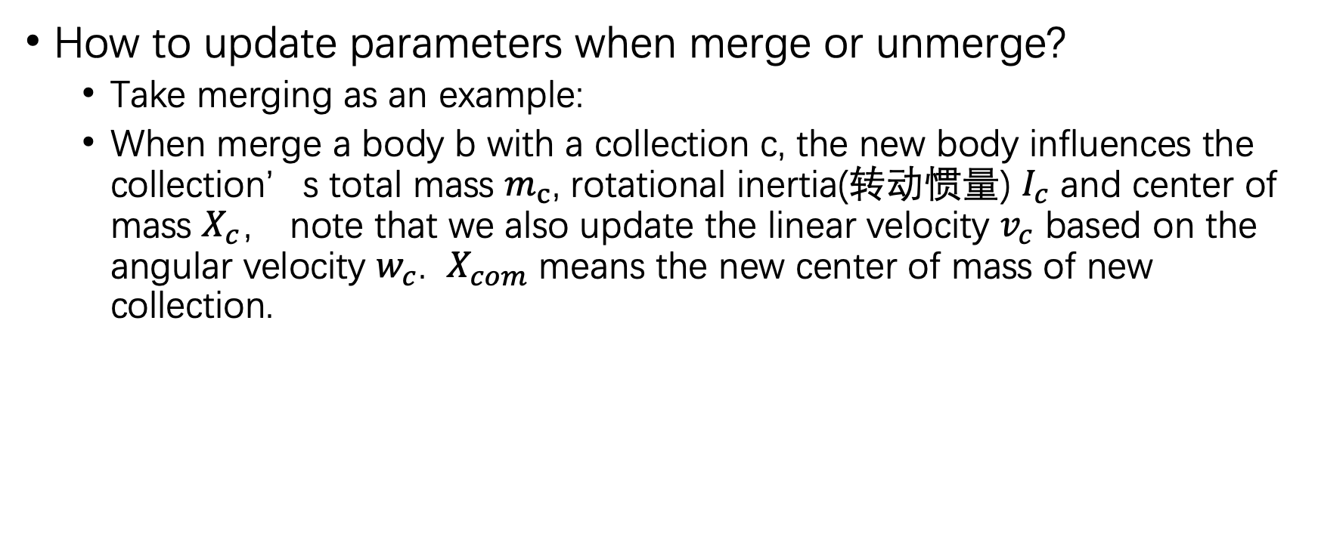
Handle Rigid Body Collection
How to update parameters when merge or unmerge?
Take merging as an example:
When merge a body b with a collection c, the new body influences the collection’s total mass $m_{c}$, rotational inertia(转动惯量) $I_{c}$ and center of mass $X_{c}$， note that we also update the linear velocity $v_{c}$ based on the angular velocity $w_{c}$. $X_{com}$ means the new center of mass of new collection.
For model detail of rotational inertia: https://en.wikipedia.org/wiki/Moment_of_inertia
Notes:
转动惯量：比较形象的来说，这个东西会产生一种现象，当我们坐在一个旋转椅子上旋转时，如果张开手臂，旋转速度会变慢，相反，如果收起手臂，旋转速度会提高。

Slide 8


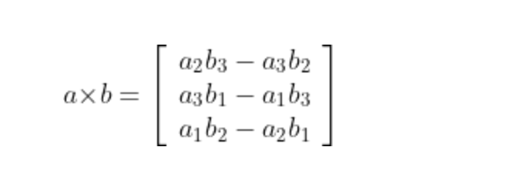
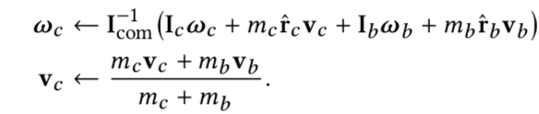
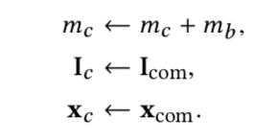
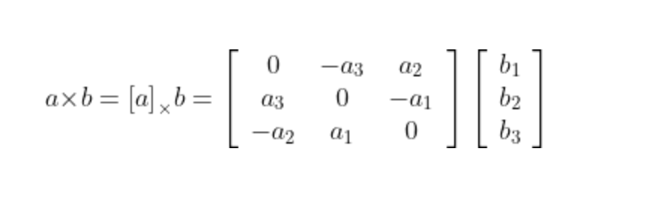

Handle Rigid Body Collection
$$r_{c}=X_{c} −X_{com} and r_{b}=X_{b} −X_{com}$$
$\hat{r_{c}}$ is a 3-by-3 product matrix

Slide 9
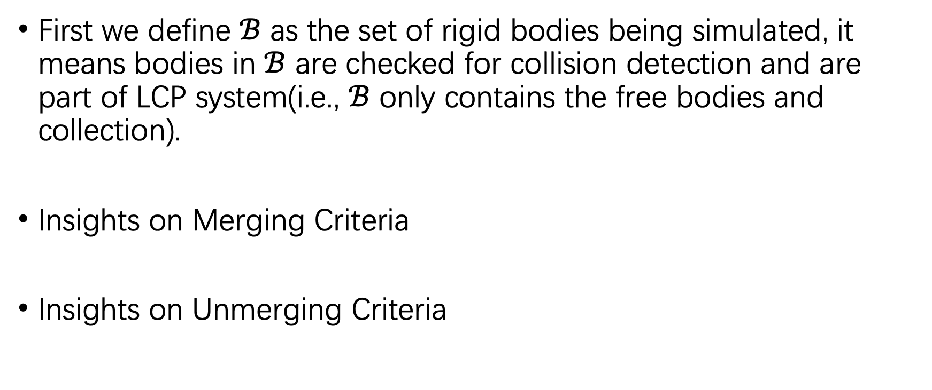
Criteria of merging and unmerging
First we define $ℬ$ as the set of rigid bodies being simulated, it means bodies in $ℬ$ are checked for collision detection and are part of LCP system(i.e., $ℬ$ only contains the free bodies and collection).
Insights on Merging Criteria
Insights on Unmerging Criteria

Slide 10
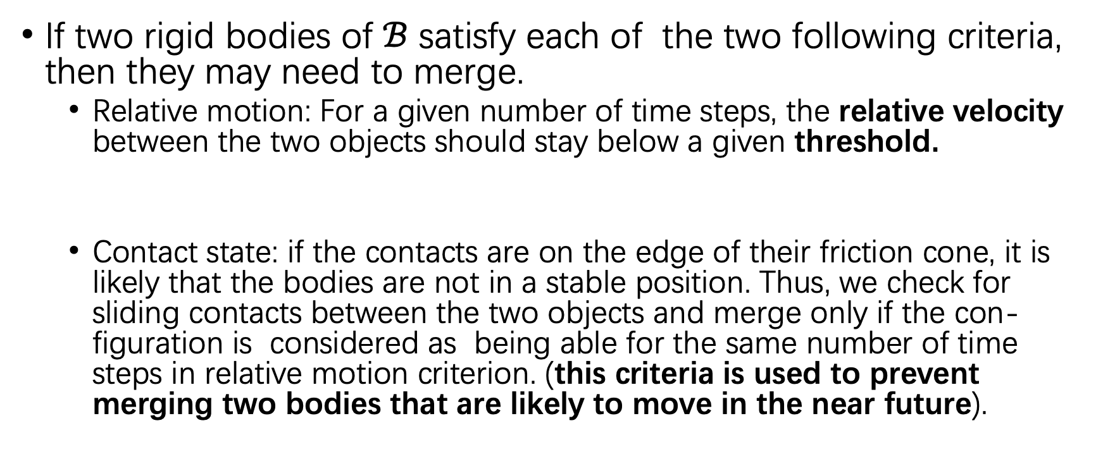
Insights on Merging Criteria
If two rigid bodies of $ℬ$ satisfy each of the two following criteria, then they may need to merge.
Relative motion: For a given number of time steps, the relative velocity between the two objects should stay below a given threshold.
Contact state: if the contacts are on the edge of their friction cone, it is likely that the bodies are not in a stable position. Thus, we check for sliding contacts between the two objects and merge only if the con-figuration is considered as being able for the same number of time steps in relative motion criterion. (this criteria is used to prevent merging two bodies that are likely to move in the near future).

Slide 11

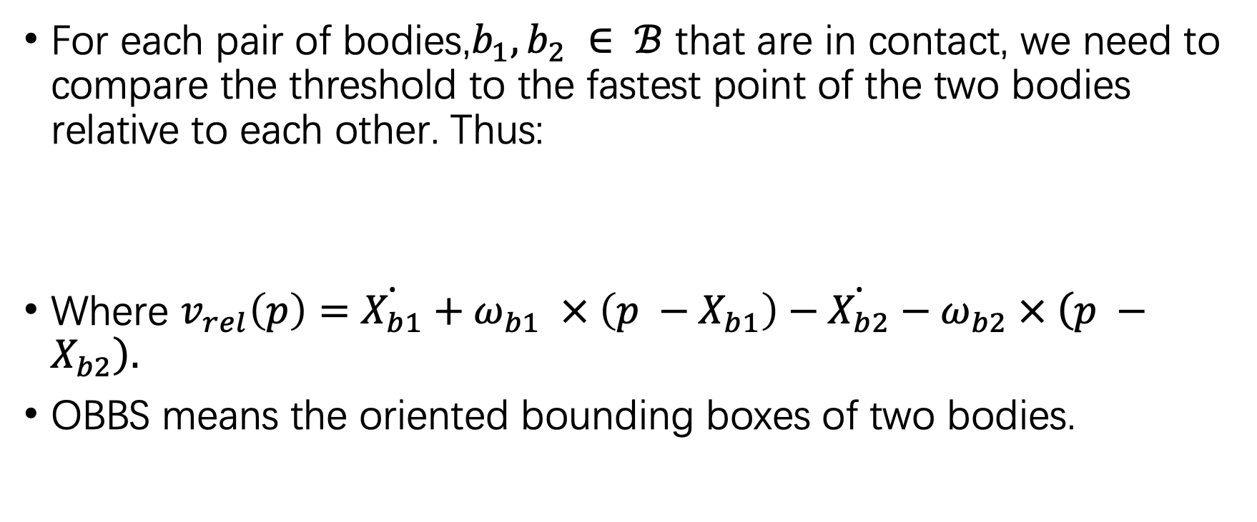
Relative Motion Metric of Merging
For each pair of bodies,$b_{1}, b_{2} ∈ ℬ$ that are in contact, we need to compare the threshold to the fastest point of the two bodies relative to each other. Thus:
Where $v_{rel}\left(p\right)=\dot{X_{b1}}+ω_{b1} × \left(p −X_{b1}\right)−\dot{X_{b2}}−ω_{b2} × \left(p −X_{b2}\right).$
OBBS means the oriented bounding boxes of two bodies.

Slide 12
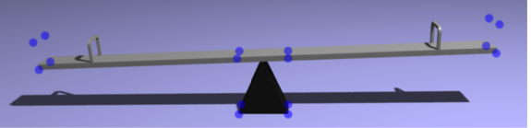
Relative Motion Metric of Merging
Why we don’t take easily the relative velocity of center of mass of these two bodies?
The blue point in image are the corner of bounding boxes. If do that, the relative velocity at the common center of mass can seem very small and fall below a naive threshold. However these two bodies still have a slow relative motion that can be more easily observed.

Slide 13

Monitoring Contact State
With friction involved, a contact has three possible states:
Inactive
Active and in static friction
Active and in dynamic friction(i.e., sliding)
Take active state as an example:
Active state means that we detected contacts which have non-zero Lagrange multipliers after the LCP slove. At this state, we check the slip velocity for every contact I and compare with a given threshold, and similarly for t2.
Notes:
如果滑动的速度超过阈值的上届，那么这两个刚体集不应该被merge。

Slide 14
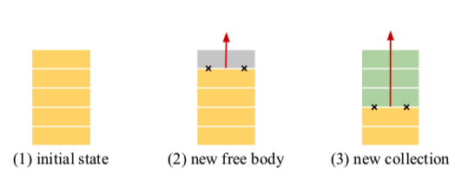
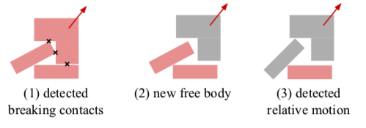
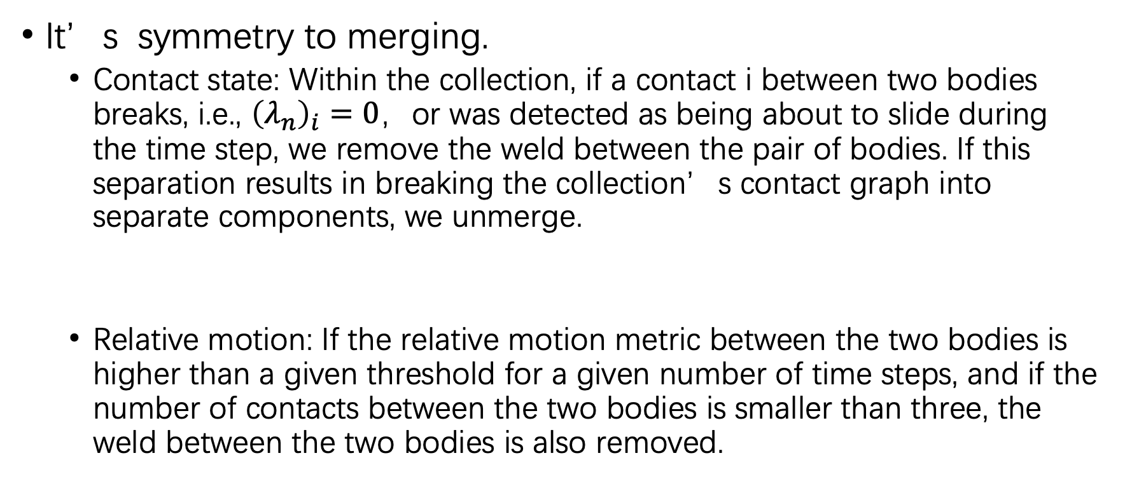
Insights on Unmerging Criteria
It’s symmetry to merging.
Contact state: Within the collection, if a contact i between two bodies breaks, i.e., ${\left(λ_{n}\right)}_{i}=0$，or was detected as being about to slide during the time step, we remove the weld between the pair of bodies. If this separation results in breaking the collection’s contact graph into separate components, we unmerge.
Relative motion: If the relative motion metric between the two bodies is higher than a given threshold for a given number of time steps, and if the number of contacts between the two bodies is smaller than three, the weld between the two bodies is also removed.
Notes:
集合内部刚体雨刚体之间可能存在多个接触点，因此，如果刚体之间的某个接触点打破了，并不意味着它们彻底独立了，可能还存在未打破的接触点。

Slide 15
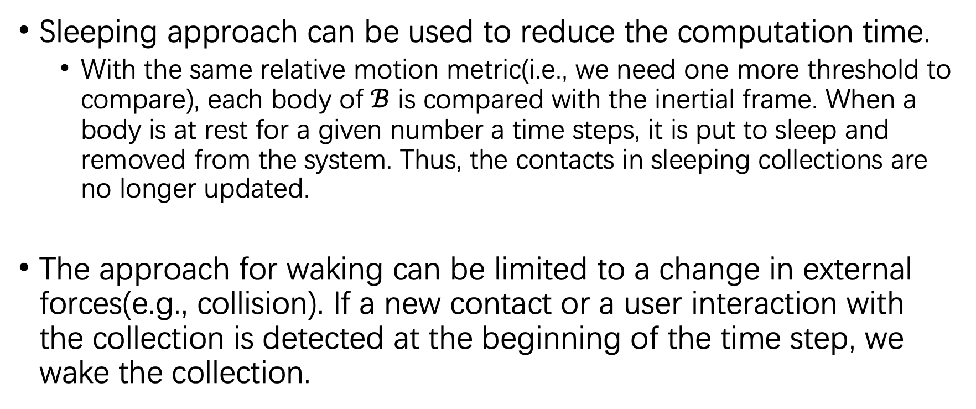
Use sleep and wake to speed up
Sleeping approach can be used to reduce the computation time.
With the same relative motion metric(i.e., we need one more threshold to compare), each body of $ℬ$ is compared with the inertial frame. When a body is at rest for a given number a time steps, it is put to sleep and removed from the system. Thus, the contacts in sleeping collections are no longer updated.
The approach for waking can be limited to a change in external forces(e.g., collision). If a new contact or a user interaction with the collection is detected at the beginning of the time step, we wake the collection.
Notes:
Waking 策略中，文中的waking策略区别于其它常见的waking方法是，当因为碰撞wake了一个休眠的刚体后，我们并不立刻对其进行unmerge操作除非PGS计算确认了它需要进行unmerge。

Slide 16
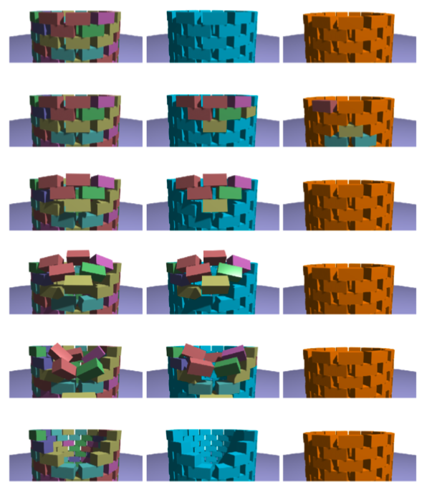
Contact ordering is important
Left: Ground truth, with no merging
Middle: Merging and contact ordering for the single iteration PGS solve
Right : Merging and no ordering of the contacts
Notes:
场景描述： 一个冲击附加在塔的顶部。可以看到最右边一列，是不进行碰撞排序的结果，塔上的刚体没有进行合理的分离，塔变得不合理的坚固、僵硬
对比之下，进行接触排序后（优先处理新检测到的碰撞），效果会更好，更符合ground truth

Slide 17
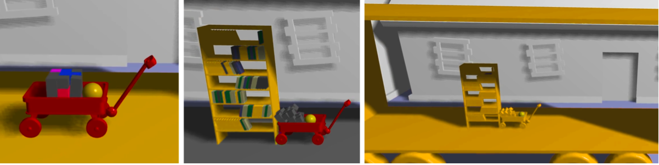
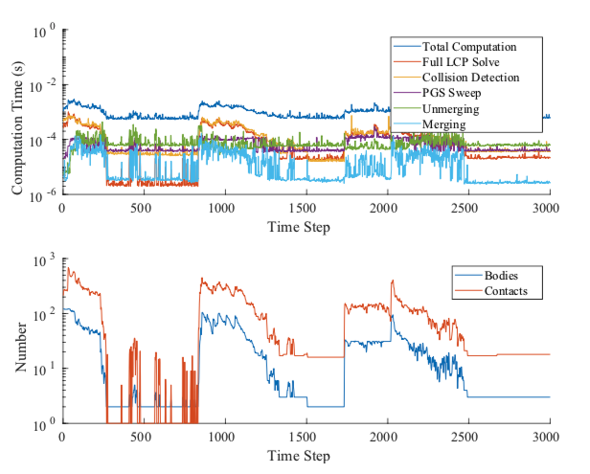
Simulation Results
Wagon scene
Notes:
The full LCP 通过10次迭代的PGS求得

Slide 18
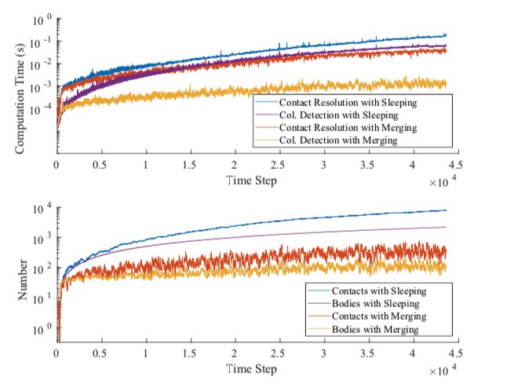
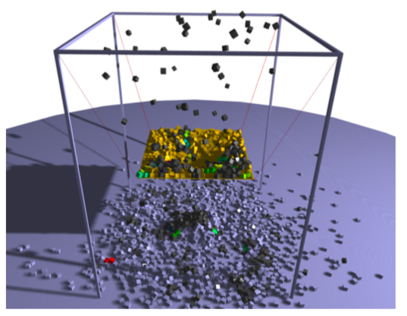
Simulation Results
Funnel scene
Notes:
立方体每N个时间片后被生成然后掉落到可晃动的漏斗上。
对不使用Adaptive Merging方法的模拟，模拟这个场景每帧需要的平均时间为62ms，计算1395个刚体和4416个接触碰撞。
使用Adaptive Merging方法后，每帧需要的平均时间降低到18ms， 426个刚体和1517个接触碰撞
大概提升了3.5倍的性能在整体的计算时间上。（这部分时间主要节省在碰撞的检测和碰撞的识别上）

Slide 19
Future work
Joint Constraints: more joints constraints(e.g., rotary, spherical, etc.)
Collision Detection: More efficiently collision detection approach
Adaptive PGS sweep: one iteration of PGS may not be enough to identify all bodies we should unmerge in some cases.
Cycles and Complete Subgraphs: handle cases when more bodies contacts form a cycle with each other
Notes:
Joint Constraints(联合约束）：很多刚体模拟工具包含了很多联合约束，但是本次工作中仅仅包含了电磁体（将接触碰撞转变为双边刚性连接）
Collision Detection： 只实现了简单策略的BVH碰撞检测加速方法（naïve tree rebalancing），虽然可以帮助剔除不少不必进行碰撞检测的刚体，但是作者认为还可以有能剔除更多刚体碰撞检测的方法
Adaptive PGS sweep： 单次PGS迭代求解对于场景中物体质量较高，且接触点多（刚体多）的情况，分离的确认效果会比较差，需要多次PGS迭代
Cycles and complete Subgraphs： 两个刚体如果仅仅只有一个接触点，这两个刚体会是很不稳定的状态（容易分离），但是如果多个刚体，如三个，围城一个圆，但每对刚体之间也仅仅只有一个接触点，虽然如此，但是这种情况的稳定性会非常高。这在处理上是需要很小心的，因为如果一个圆内的某对物体之间的接触被打破了，这意味着整个圆状内的所有刚体将处于一个不稳定的状态，而不仅仅只是将那对刚体之间的接触记录移除。这种情况在2D上进行了探究，但3D上没有加入。

Slide 20
Thanks

